Slide 1
PPL KELOMPOK 6
Fajar Widhi Arianto – A11.2018.11337
A. Kamal Hidayat – A11.2018.11333
Alvian Bagaswara – A11.2018.13207
R Bagas Satrio Hutomo – A11.2018.11544
Dicky Cahya Putra Ramanda – A11.2018.11283

Slide 2

Project cover

Slide 3
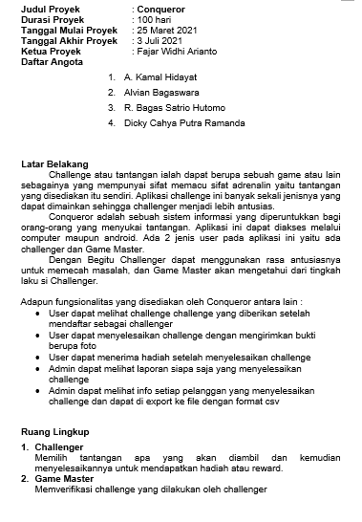
Project scope statement
Project scope ini berisi tentang Latar belakang proyek ini dilaksanakan,daftar fitur/fungsionalitas yang disediakan,dan ruang lingkup proyek

Slide 4
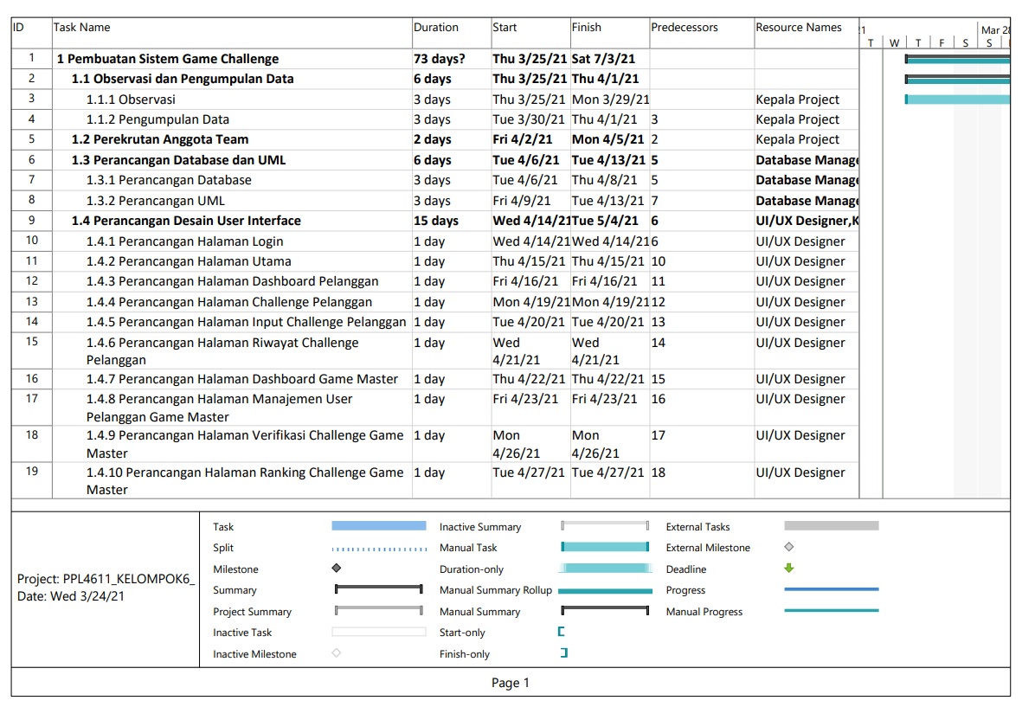
Work Breakdown Structure

Slide 5
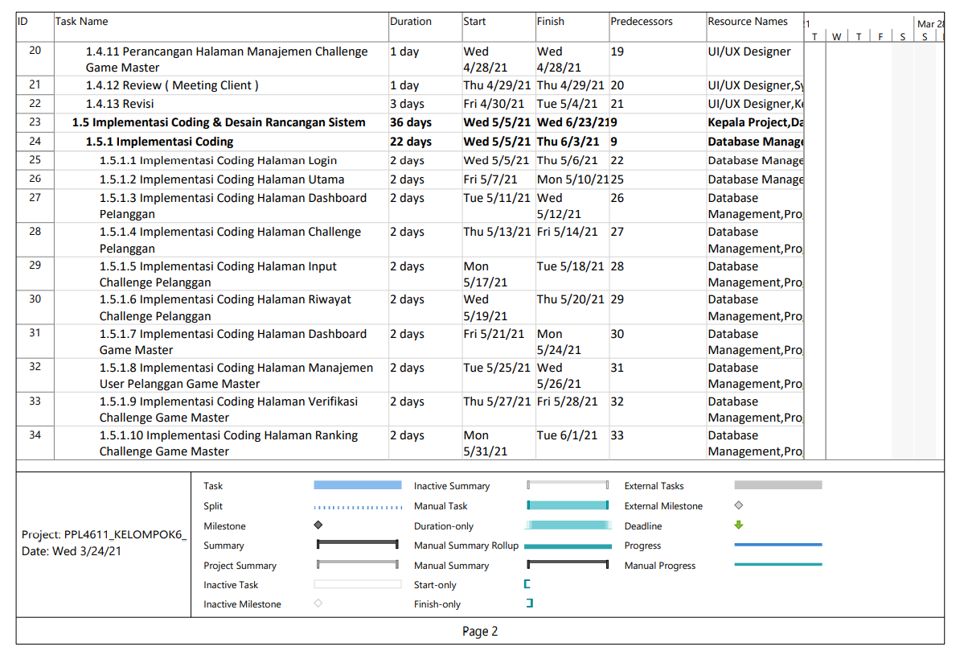
Work Breakdown Structure

Slide 6
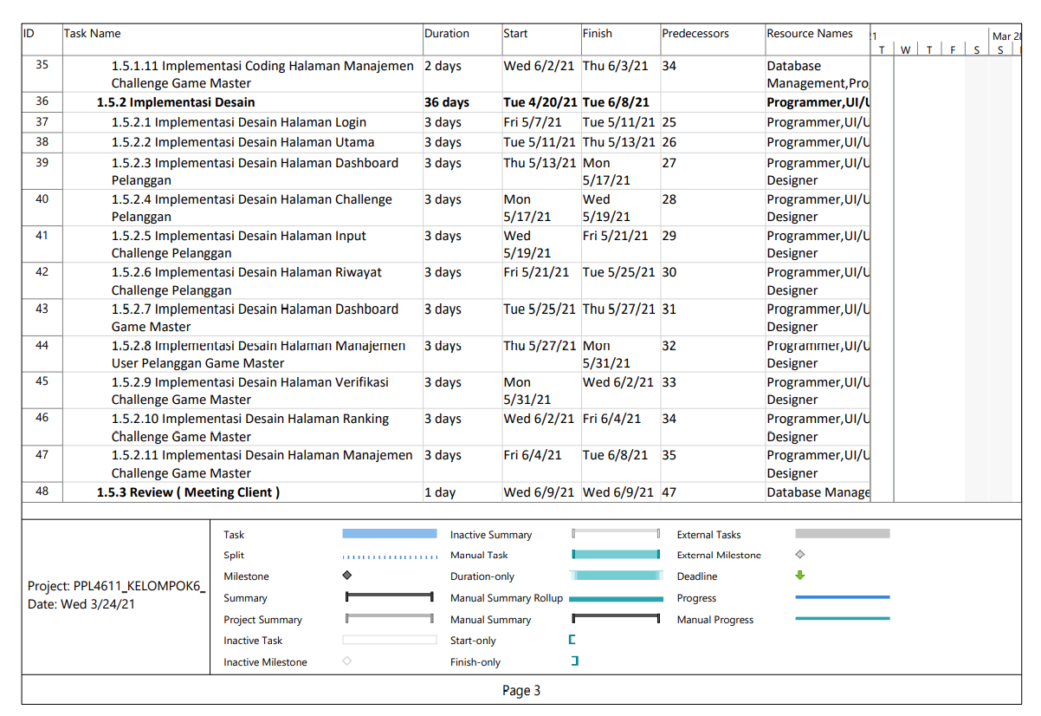
Work Breakdown Structure

Slide 7
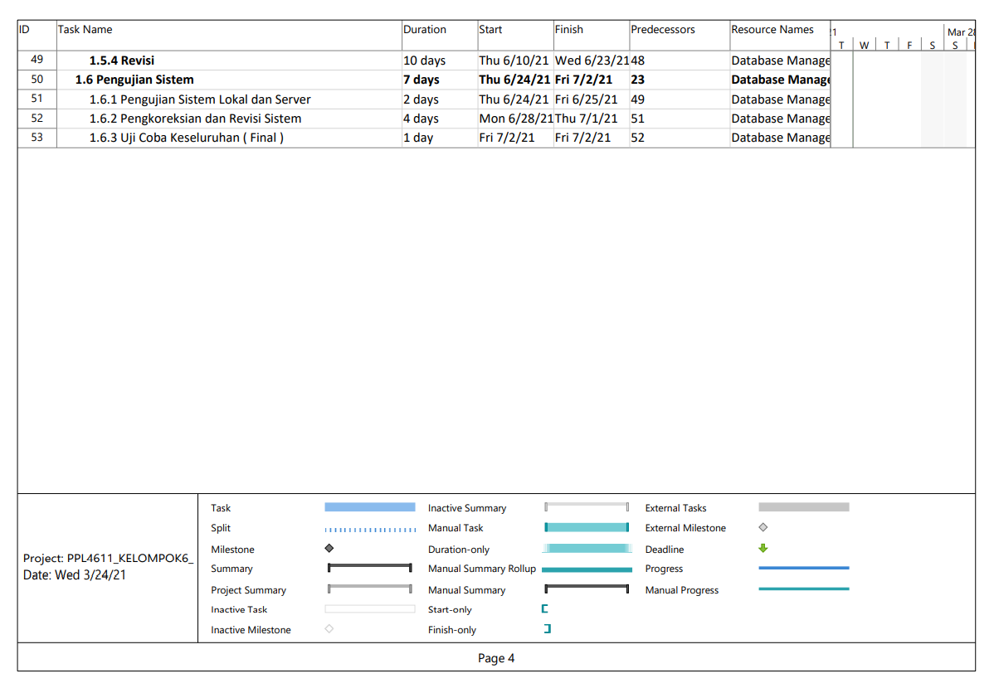
Work Breakdown Structure

Slide 8
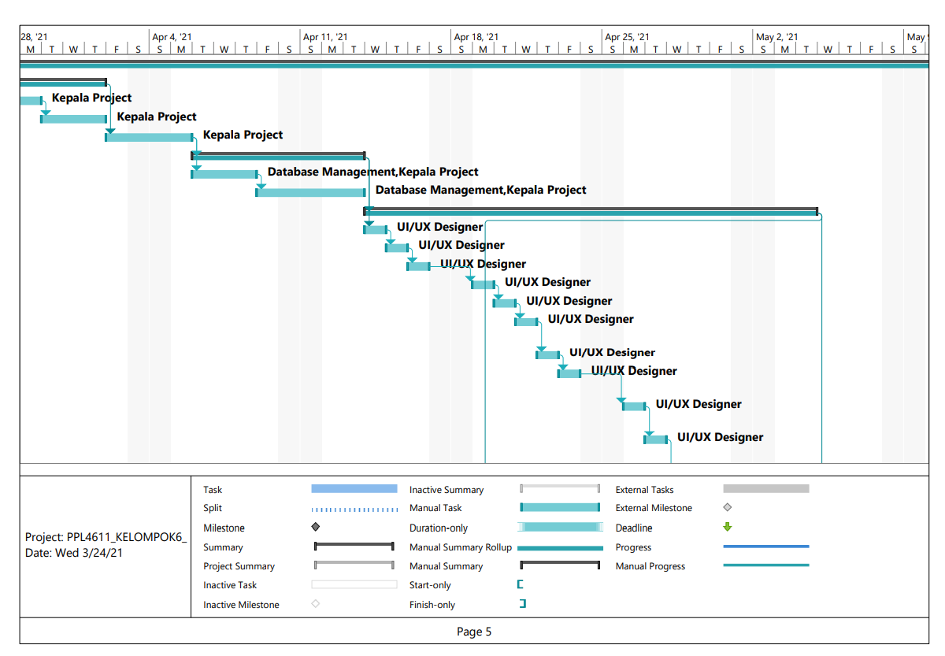
Work Breakdown Structure

Slide 9
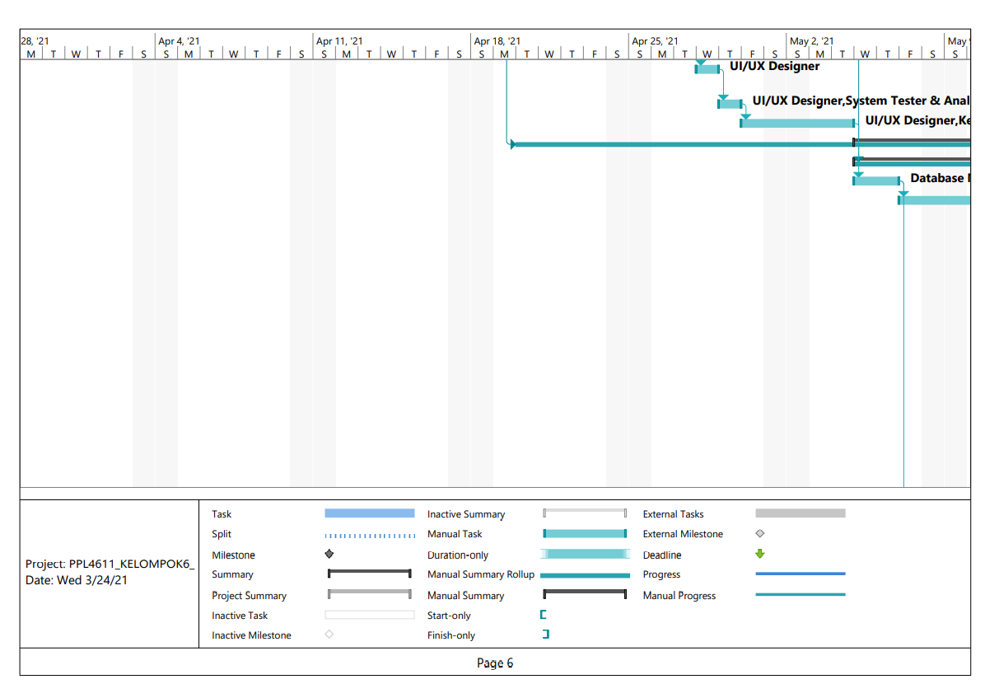
Work Breakdown Structure

Slide 10
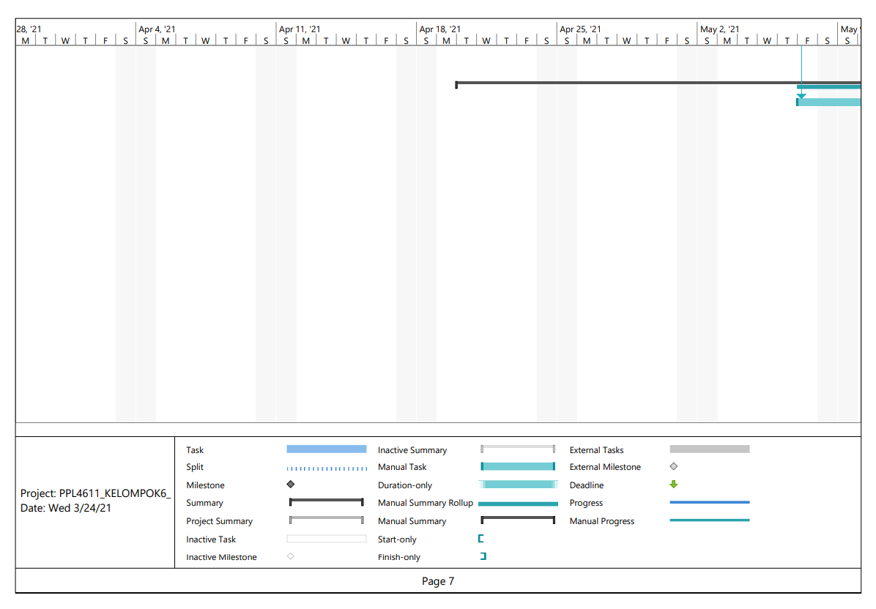
Work Breakdown Structure

Slide 11
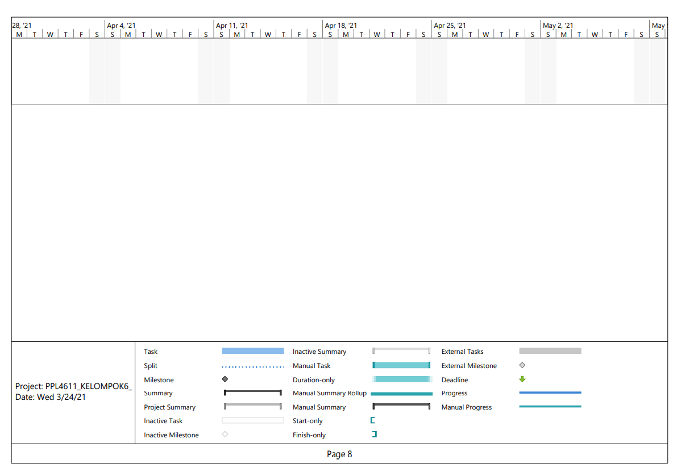
Work Breakdown Structure

Slide 12
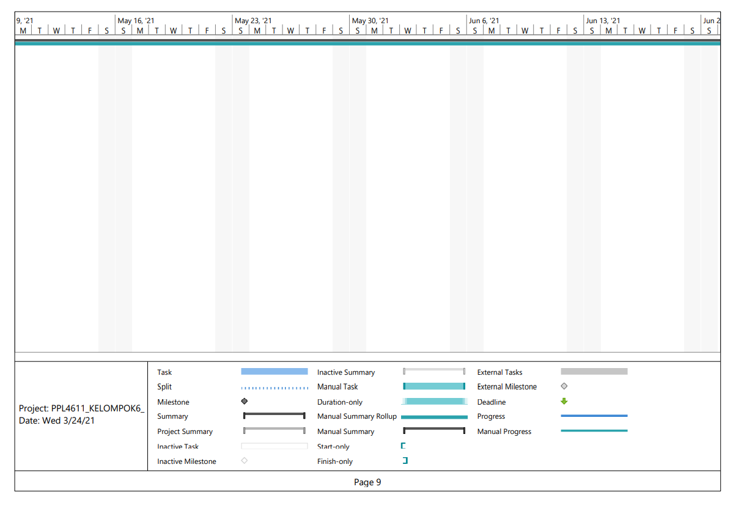
Work Breakdown Structure

Slide 13
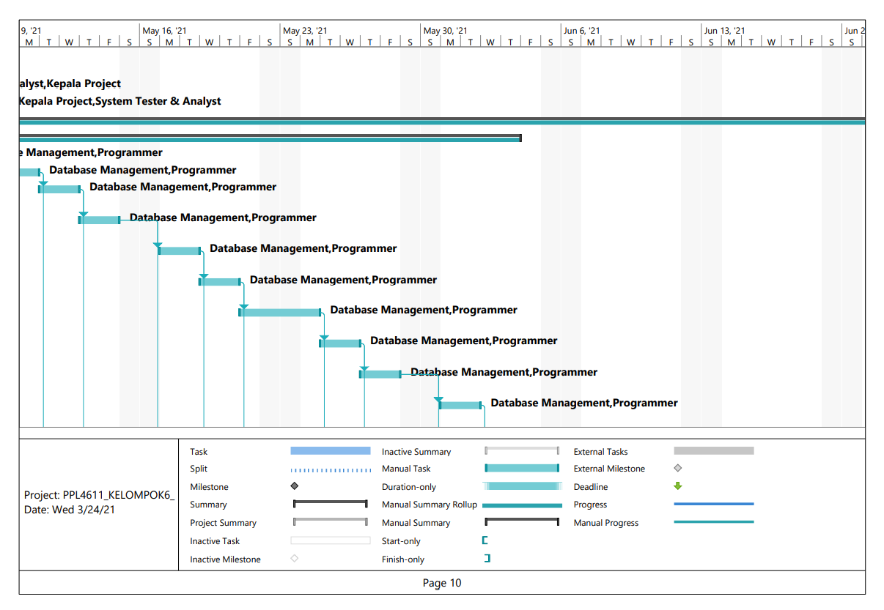
Work Breakdown Structure

Slide 14
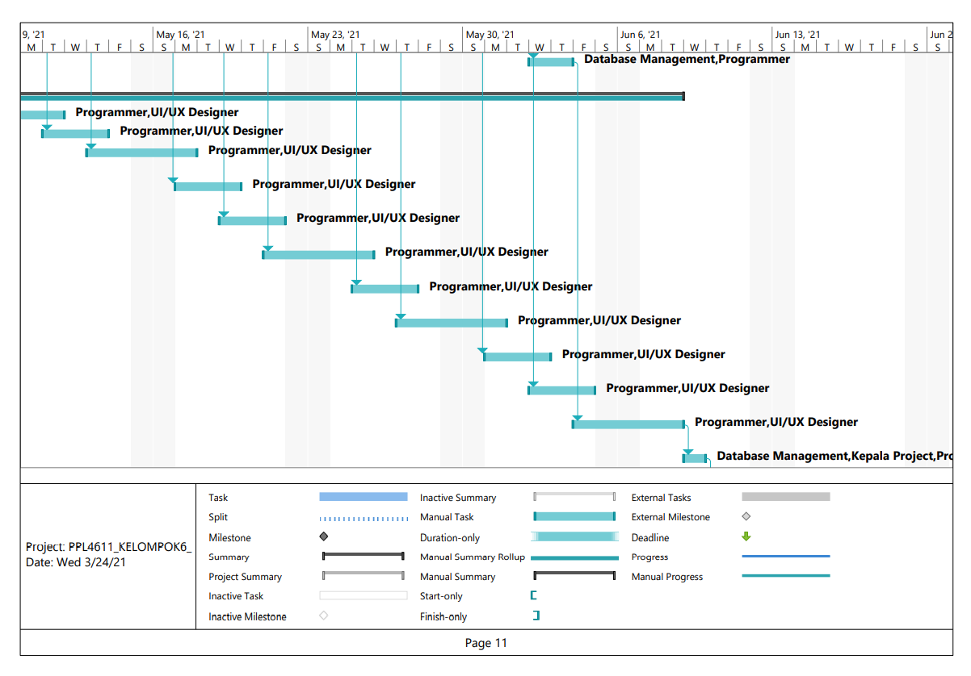
Work Breakdown Structure

Slide 15
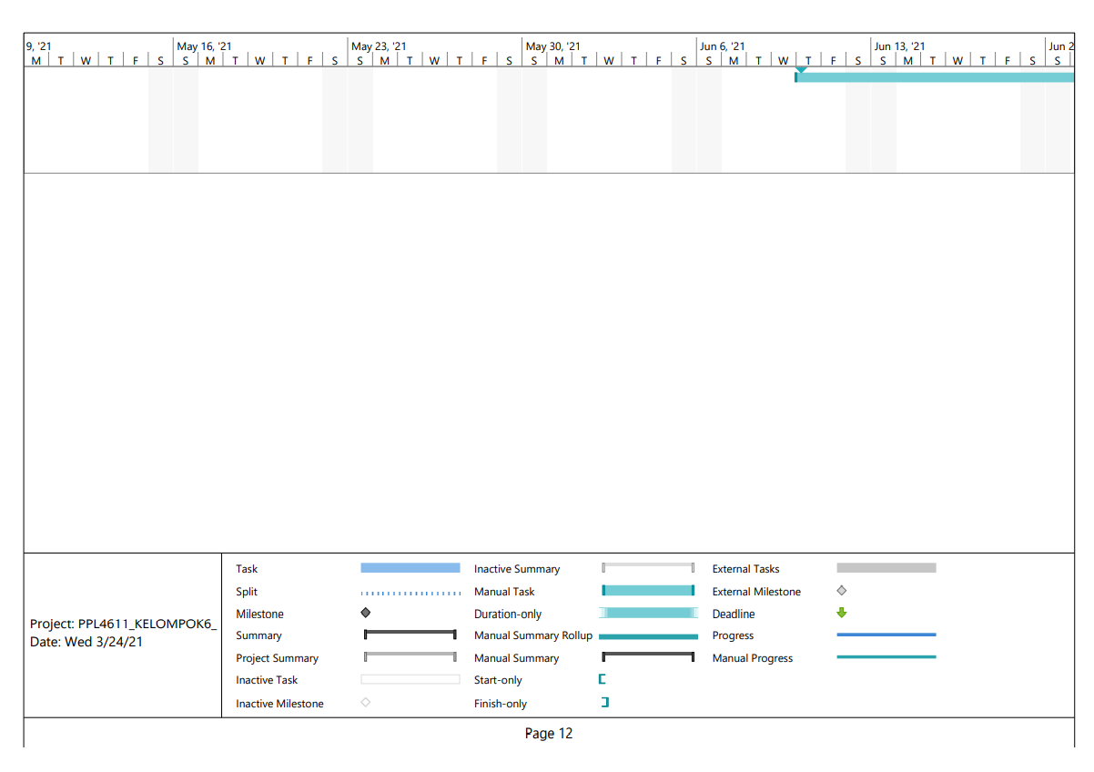
Work Breakdown Structure

Slide 16
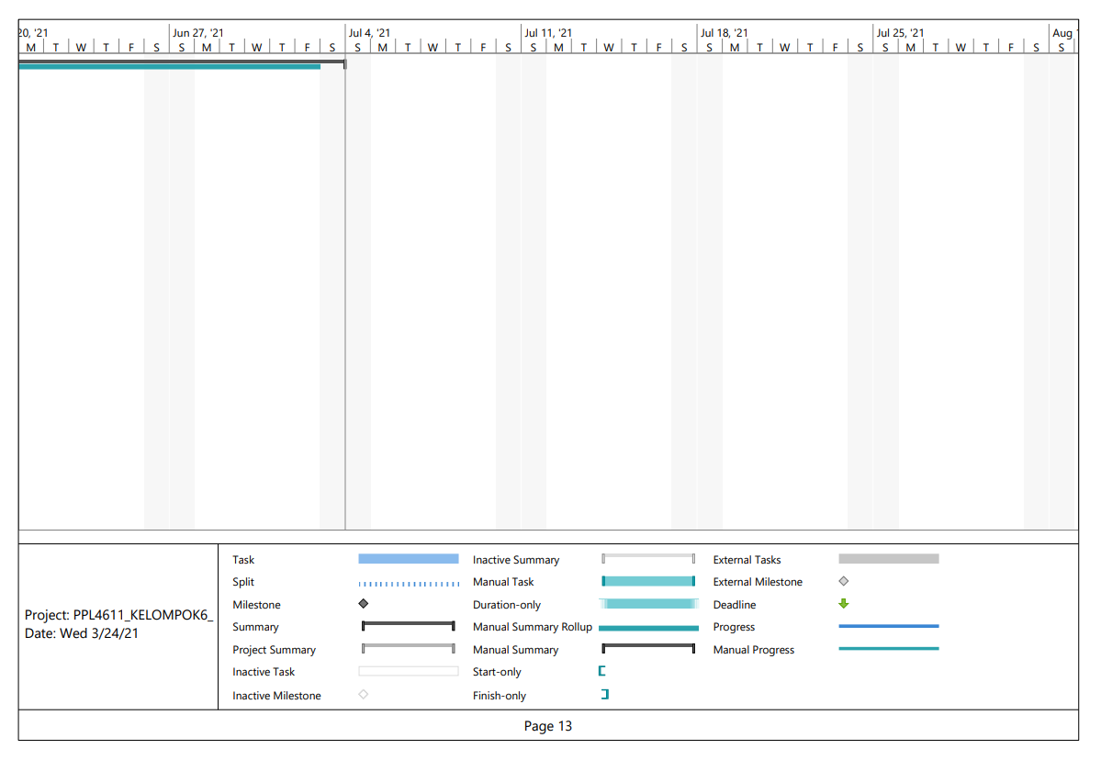
Work Breakdown Structure

Slide 17
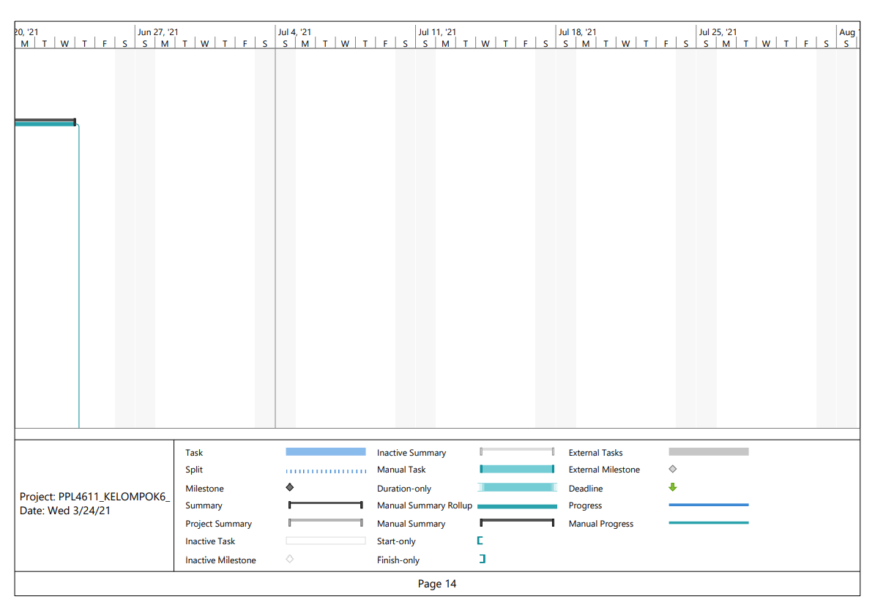
Work Breakdown Structure

Slide 18
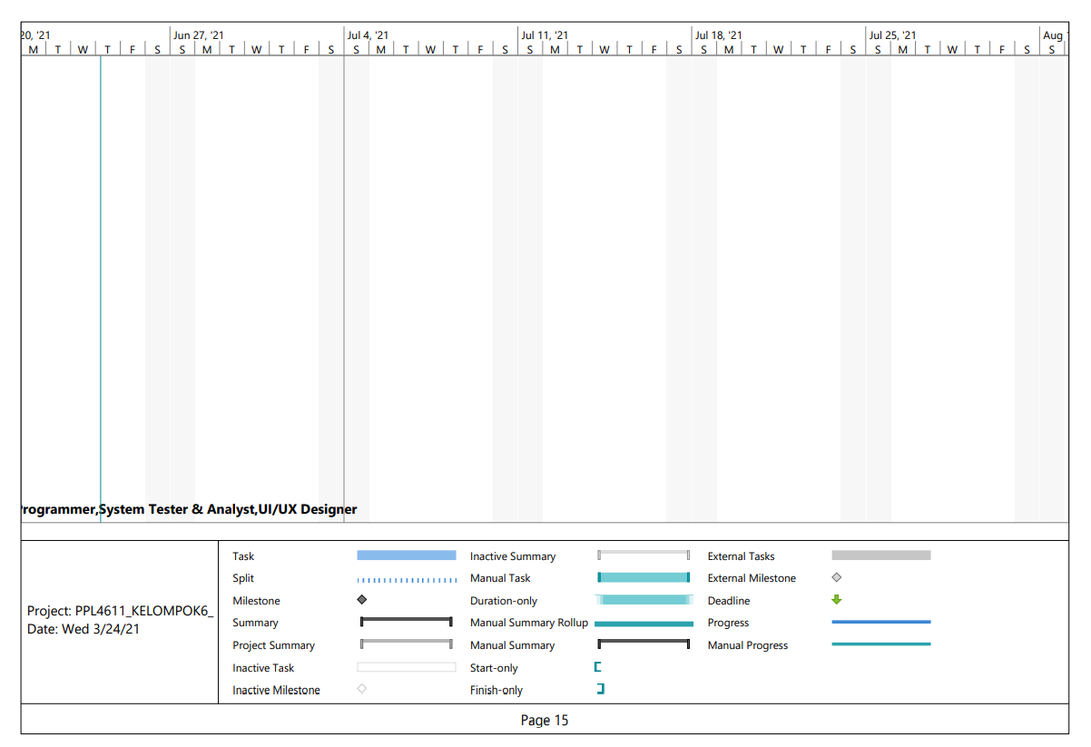
Work Breakdown Structure

Slide 19
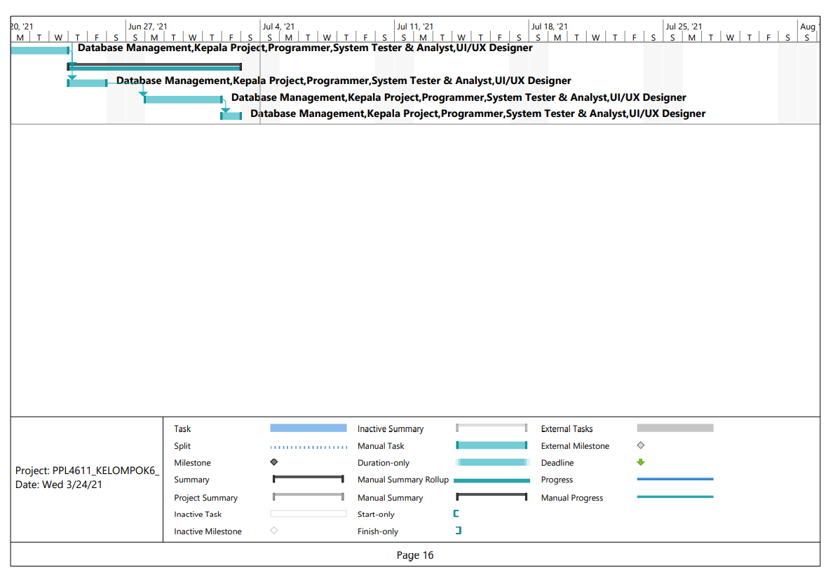
Work Breakdown Structure

Slide 20
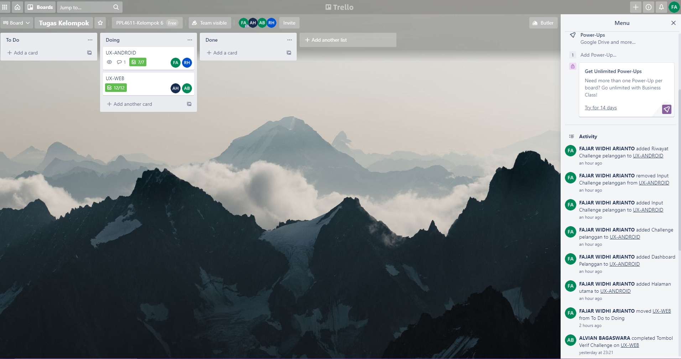
Project management tool

Slide 21
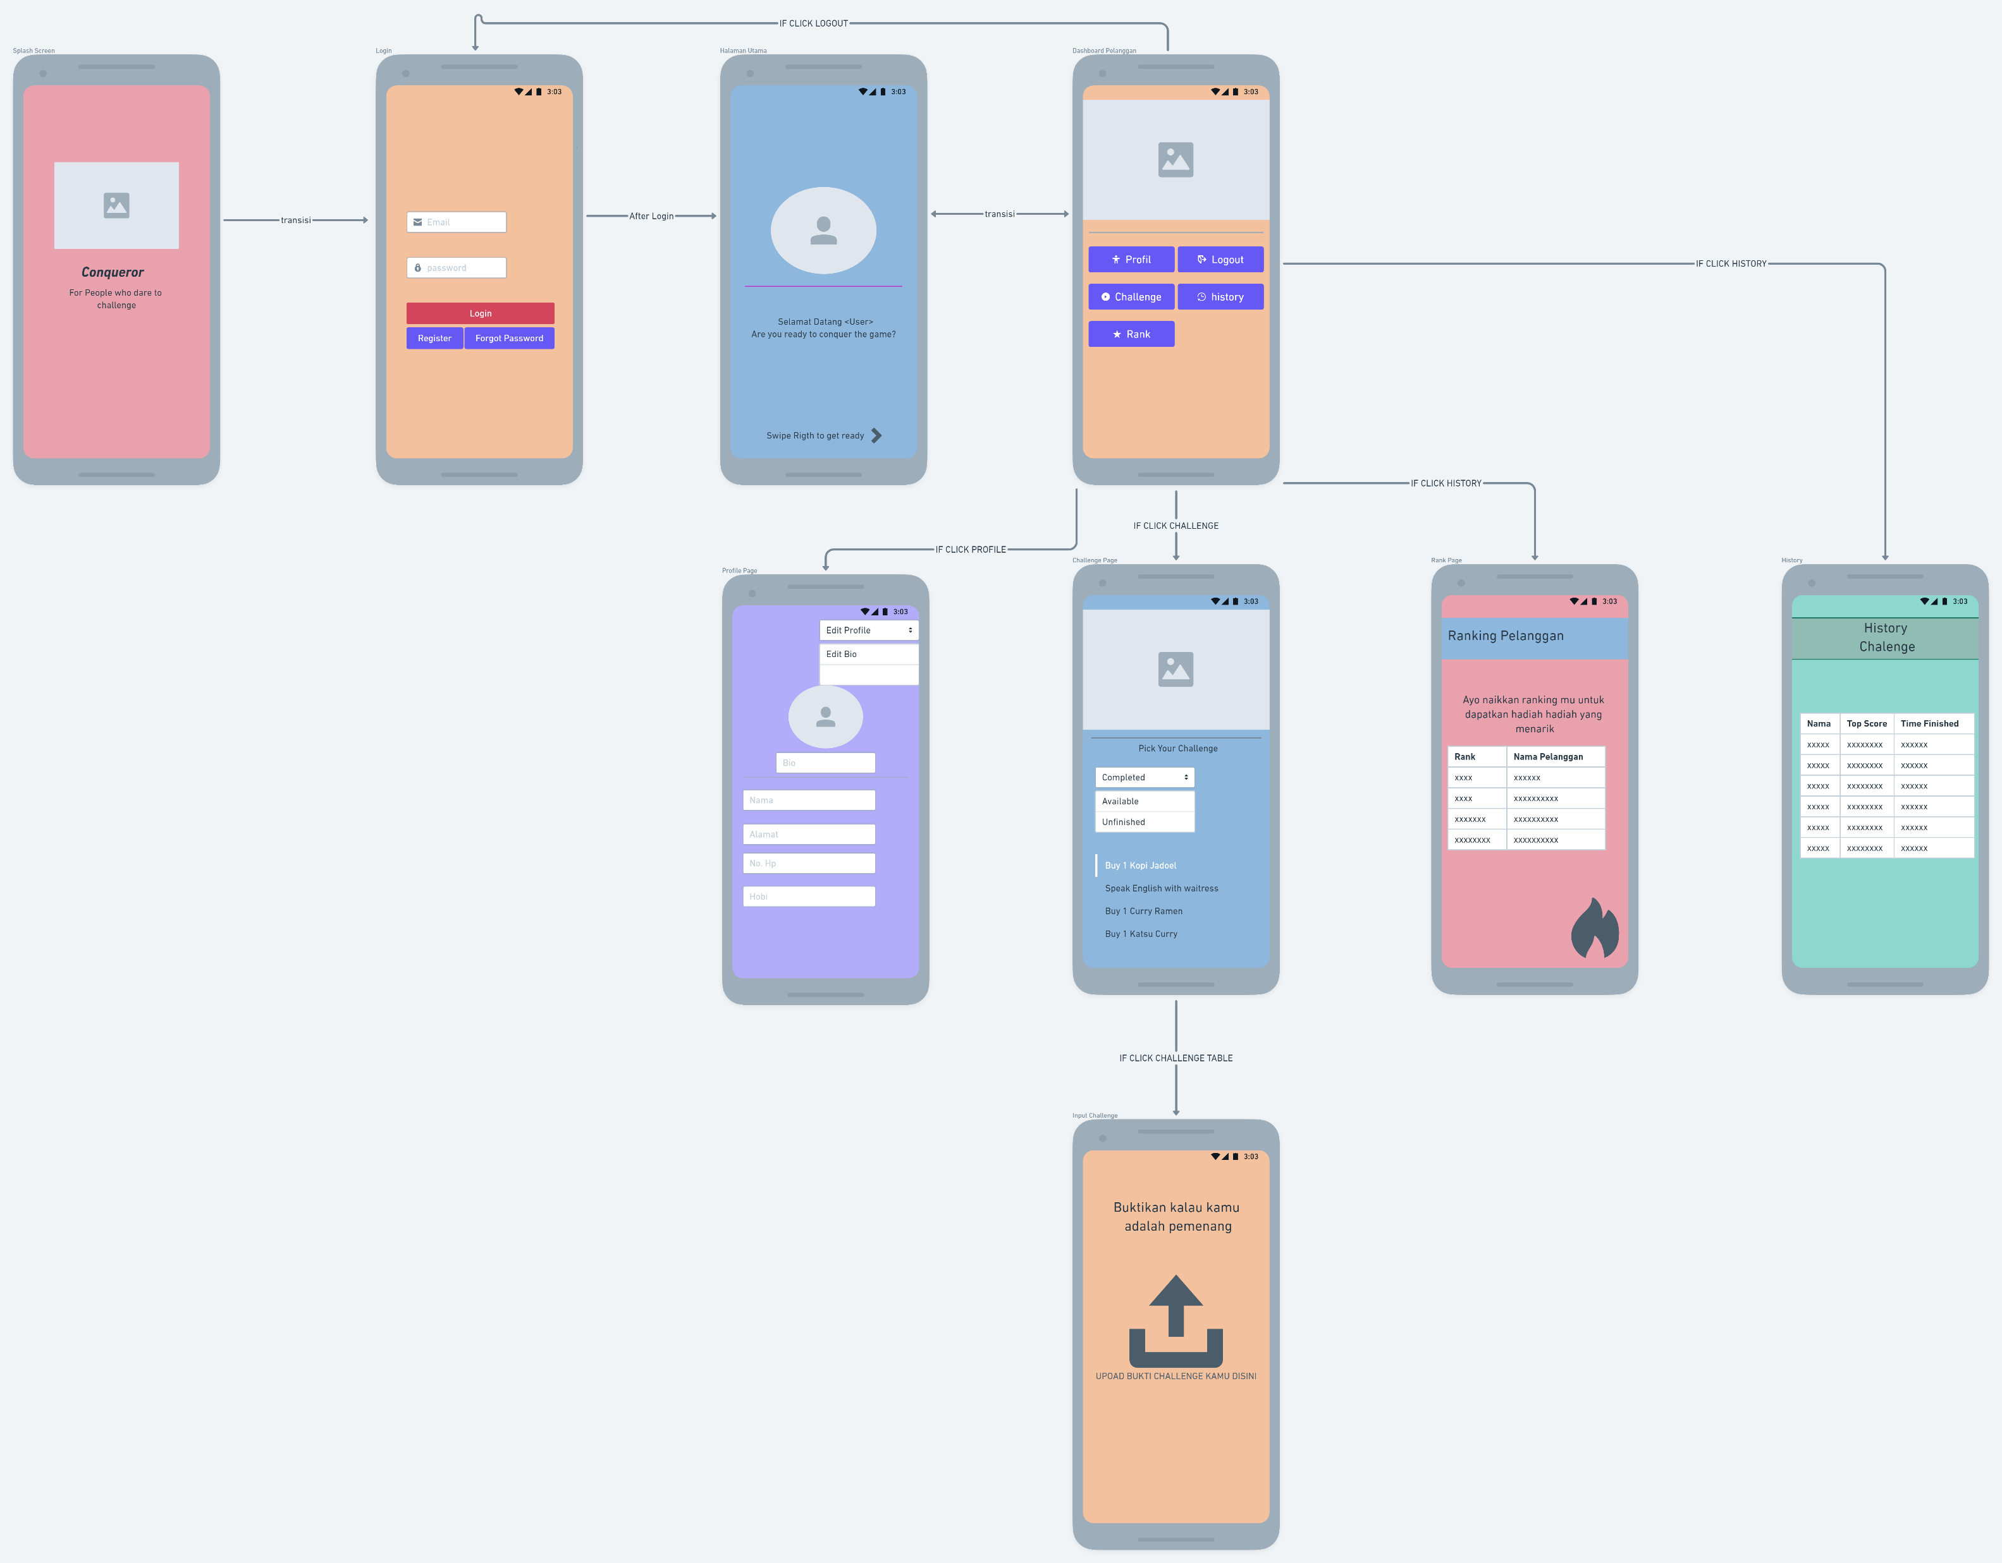
Wireframe Android

Slide 22
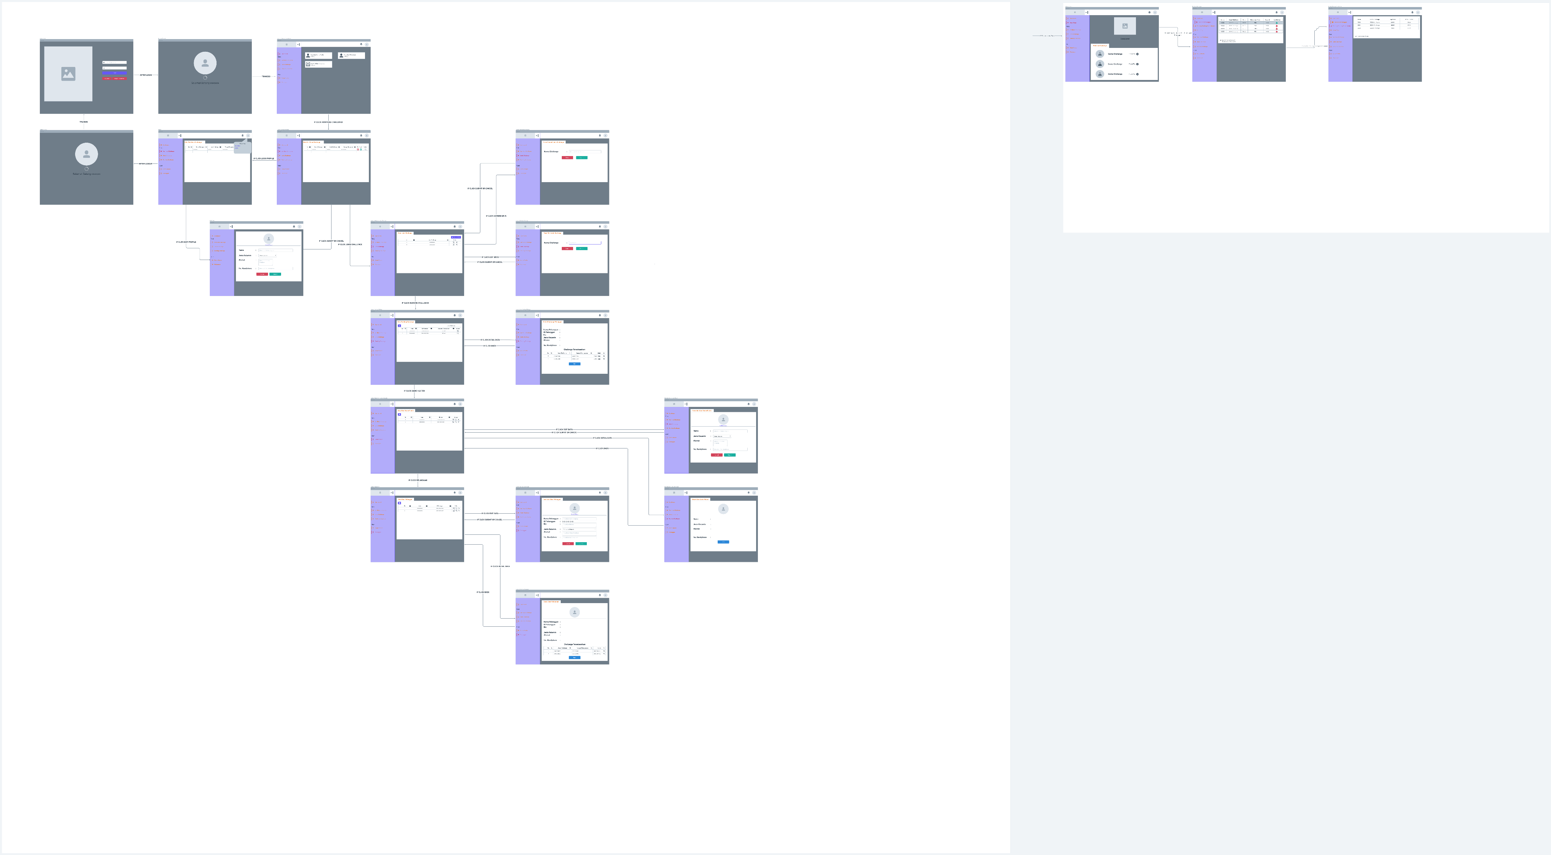
Wireframe Web

